Slide 1
Automated Peak Detection Information Slides
By Aleksander Berezowski

Slide 2
General Process
Read CSV Array
For each row in CSV Array
Clean data via moving average filter
Find peaks via scipy peak detection using prominence
Find valleys via scipy peak detection using prominence
Return peaks and valleys

Slide 3
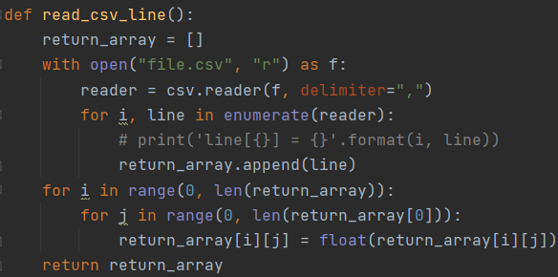
Read CSV Array
Standard python to read a CSV array
2D array
Each line of the file is an array
Inner arrays contains the values delimited via a comma

Slide 4
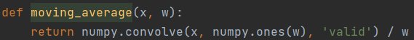
Clean data via moving average filter
Standard moving average filter
Numpy package makes it easy

Slide 5
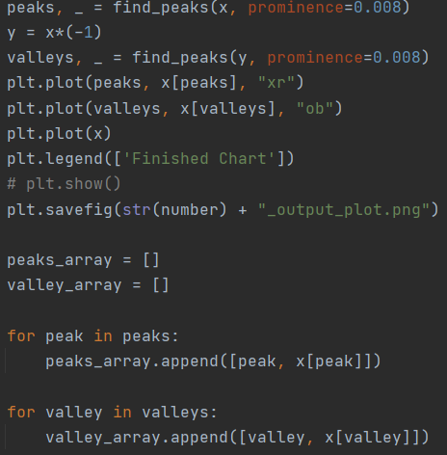
Find peaks / valleys via scipy peak detection using prominence
Scipy package makes it easy
“The prominence of a peak measures how much a peak stands out from the surrounding baseline of the signal and is defined as the vertical distance between the peak and its lowest contour line.”

Slide 6
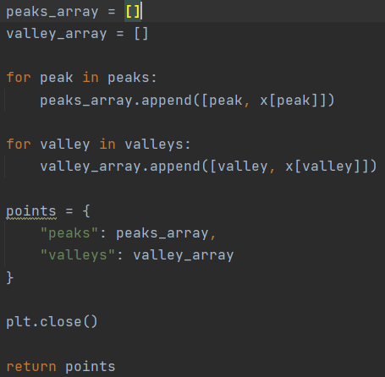
Return peaks and valleys
Put data for peaks and valleys into separate arrays
Return arrays in dictionary for use

